Slide 1
9
Muscles and Muscle Tissue: Part B

Slide 2
Review Principles of Muscle Mechanics
Same principles apply to contraction of single fiber and whole muscle
Contraction produces muscle tension, force exerted on load or object to be moved
© 2013 Pearson Education, Inc.

Slide 3
Review Principles of Muscle Mechanics
Contraction may/may not shorten muscle
  Isometric contraction: no shortening; muscle tension increases but does not exceed load
  Isotonic contraction: muscle shortens because muscle tension exceeds load
Force and duration of contraction vary in response to stimuli of different frequencies and intensities
© 2013 Pearson Education, Inc.

Slide 4
Motor Unit: The Nerve-Muscle Functional Unit
Each muscle served by at least one motor nerve
  Motor nerve contains axons of up to hundreds of motor neurons
  Axons branch into terminals, each of which → NMJ with single muscle fiber
Motor unit = motor neuron and all (four to several hundred) muscle fibers it supplies
  Smaller number = fine control
© 2013 Pearson Education, Inc.

Slide 5
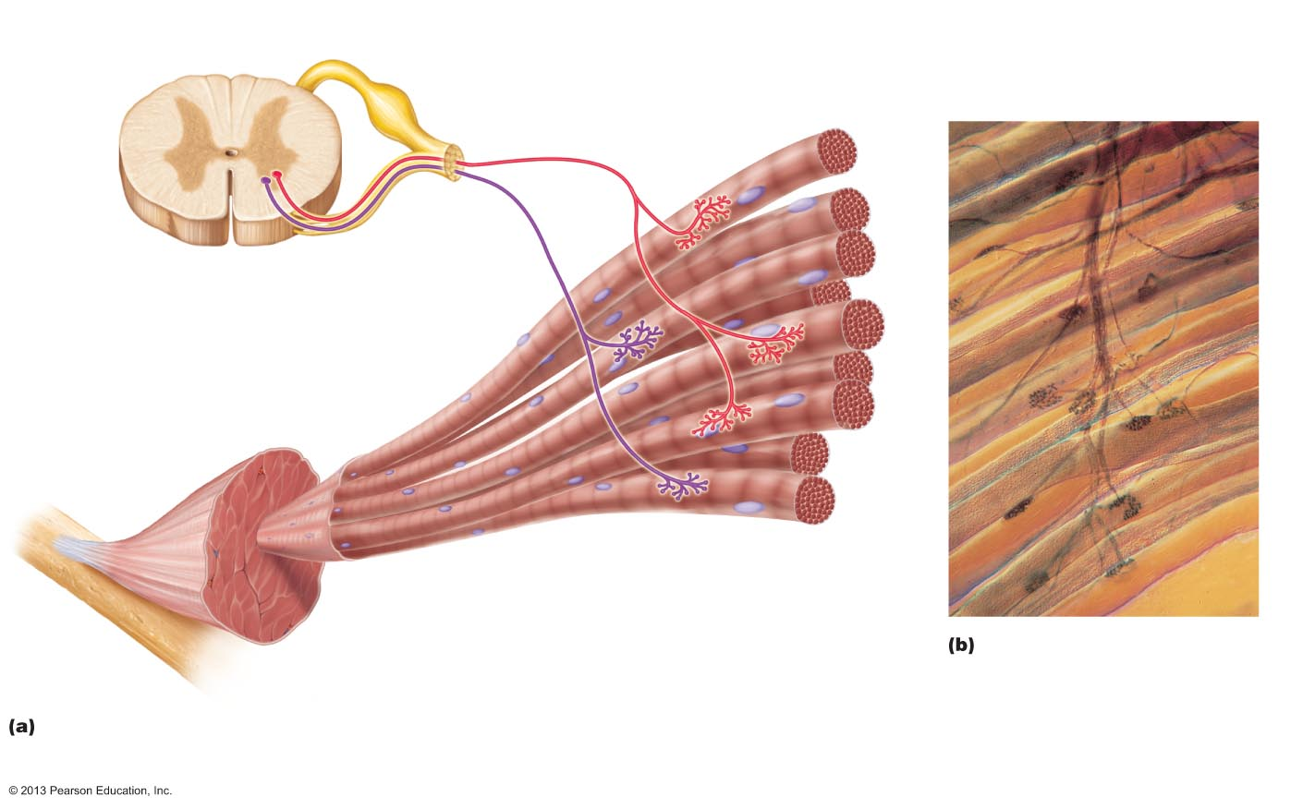
Figure 9.13 A motor unit consists of one motor neuron and all the muscle fibers it innervates.
Spinal cord
Axon terminals at
neuromuscular junctions
Branching axon
to motor unit
Motor
unit 1
Motor
unit 2
Nerve
Motor neuron
cell body
Motor neuron
axon
Muscle
Muscle
fibers
Branching axon terminals form
neuromuscular junctions, one
per muscle fiber (photomicro-
graph 330x).
Axons of motor neurons extend from the spinal cord to the muscle. There each axon divides into a number of axon terminals that form neuromuscular junctions with muscle fibers scattered throughout the muscle.
© 2013 Pearson Education, Inc.

Slide 6
Motor Unit
Muscle fibers from motor unit spread throughout muscle so single motor unit causes weak contraction of entire muscle
Motor units in muscle usually contract asynchronously; helps prevent fatigue
© 2013 Pearson Education, Inc.

Slide 7
Muscle Twitch抽搐
Motor unit's response to single action potential of its motor neuron
Simplest contraction observable in lab (recorded as myogram[医]肌动(描记)图)
© 2013 Pearson Education, Inc.

Slide 8
Muscle Twitch
Three phases of muscle twitch
  Latent period: events of excitation-contraction coupling; no muscle tension
  Period of contraction: cross bridge formation; tension increases
  Period of relaxation: Ca²⁺ reentry into SR; tension declines to zero
Muscle contracts faster than it relaxes
© 2013 Pearson Education, Inc.

Slide 9
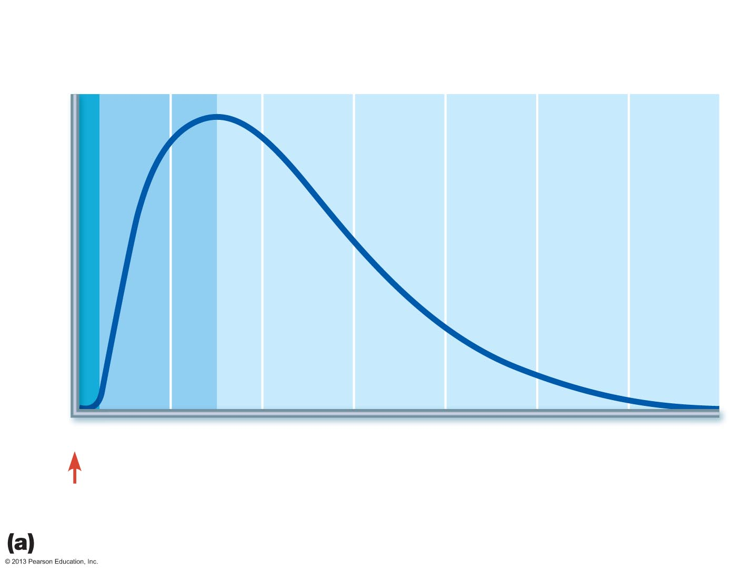
Figure 9.14a The muscle twitch.
Latent
period
Period of
contraction
Period of
relaxation
Percentage of
maximum tension
0
20
40
60
80
100
120
140
Time (ms)
Single
stimulus
Myogram showing the three phases of an isometric twitch
© 2013 Pearson Education, Inc.

Slide 10
Muscle Twitch Comparisons
Different strength and duration of twitches due to variations in metabolic properties and enzymes between muscles
Muscle twitch only in lab or neuromuscular problems; normal muscle contraction smooth
© 2013 Pearson Education, Inc.

Slide 11
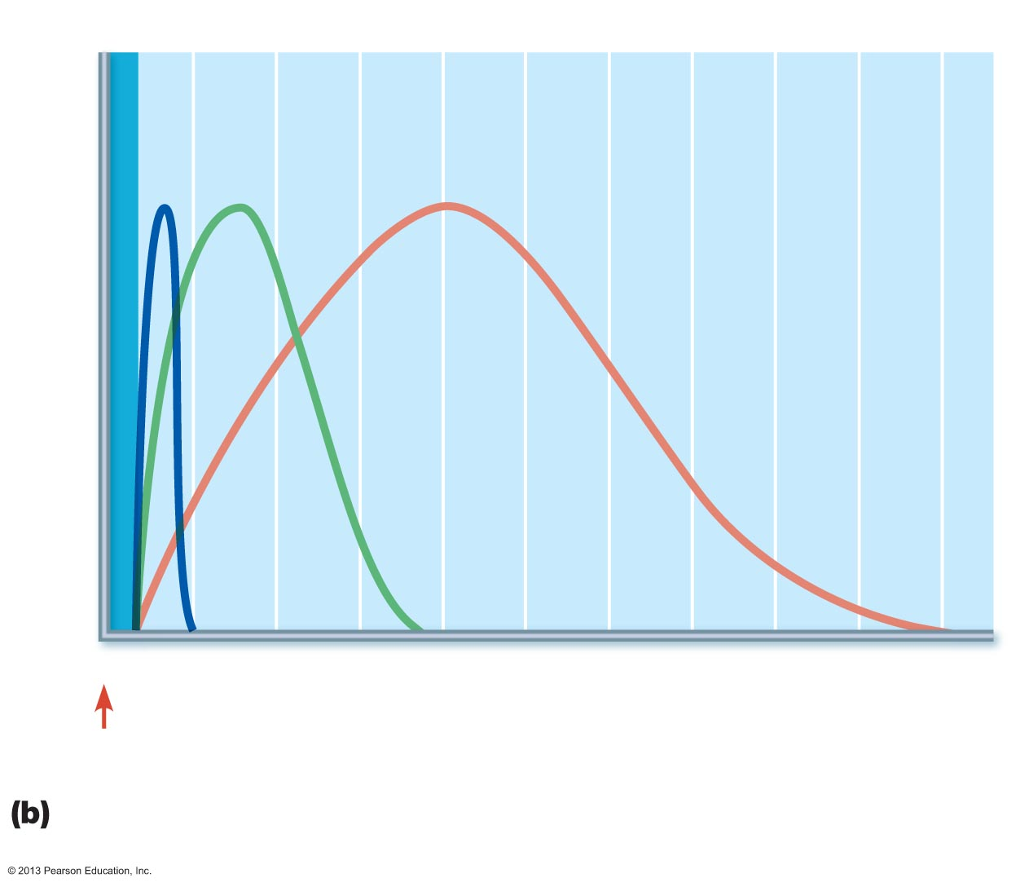
Figure 9.14b The muscle twitch.
Latent period
Extraocular muscle (lateral rectus)
Gastrocnemius
Soleus
Percentage of
maximum tension
0
40
80
120
160
200
Time (ms)
Single
stimulus
Comparison of the relative duration of twitch responses of
three muscles
© 2013 Pearson Education, Inc.

Slide 12
Graded Muscle Responses
Graded muscle responses
  Varying strength of contraction for different demands
Required for proper control of skeletal movement
Responses graded by
  Changing frequency of stimulation
  Changing strength of stimulation
© 2013 Pearson Education, Inc.

Slide 13
Response to Change in Stimulus Frequency
Single stimulus results in single contractile response—muscle twitch
© 2013 Pearson Education, Inc.

Slide 14
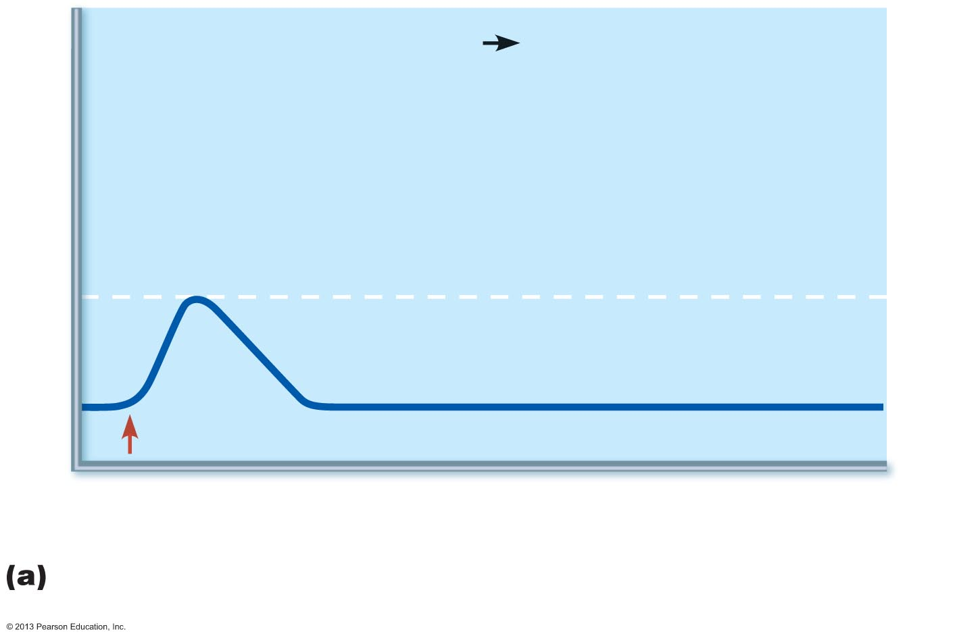
Figure 9.15a A muscle's response to changes in stimulation frequency.
Single stimulus single twitch
Tension
Contraction
Maximal tension of a single twitch
Relaxation
0
Stimulus
100
200
300
Time (ms)
A single stimulus is delivered. The muscle contracts and relaxes.
© 2013 Pearson Education, Inc.

Slide 15
Response to Change in Stimulus Frequency
Wave (temporal) summation
  Increased stimulus frequency (muscle does not completely relax between stimuli) → second contraction of greater force
    Additional Ca²⁺ release with second stimulus stimulates more shortening
    Produces smooth, continuous contractions
Further increase in stimulus frequency → unfused (incomplete) tetanus
© 2013 Pearson Education, Inc.

Slide 16
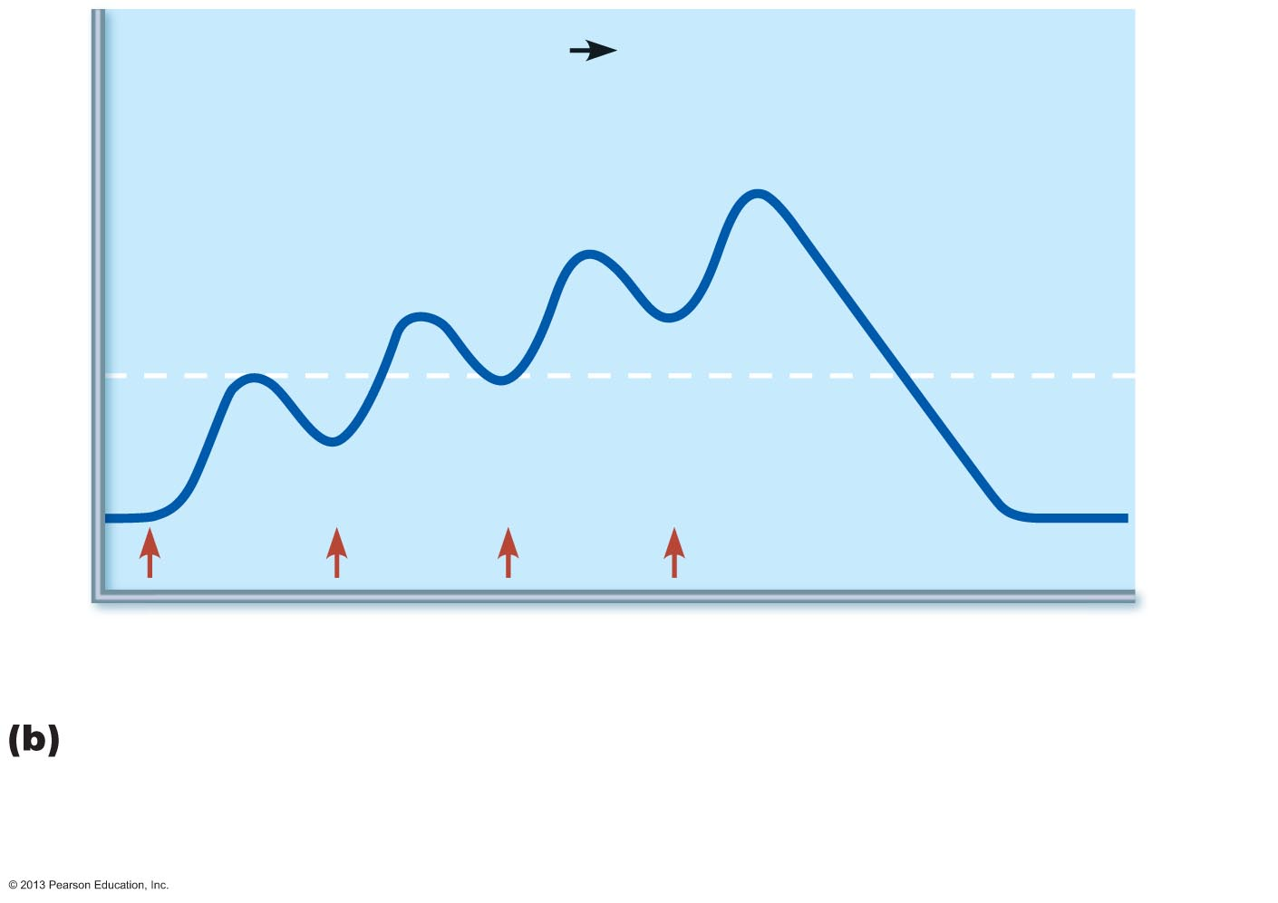
Figure 9.15b A muscle's response to changes in stimulation frequency.
Low stimulation
frequency
unfused (incomplete)
tetanus
Tension
Partial relaxation
0
Stimuli
100
200
300
Time (ms)
If another stimulus is applied before the muscle relaxes
completely, then more tension results. This is wave (or
temporal) summation and results in unfused (or incomplete) tetanus.
© 2013 Pearson Education, Inc.

Slide 17
Response to Change in Stimulus Frequency
If stimuli are given quickly enough, muscle reaches maximal tension → fused (complete) tetany results
  Smooth, sustained contraction
  No muscle relaxation → muscle fatigue
    Muscle cannot contract; zero tension
© 2013 Pearson Education, Inc.

Slide 18
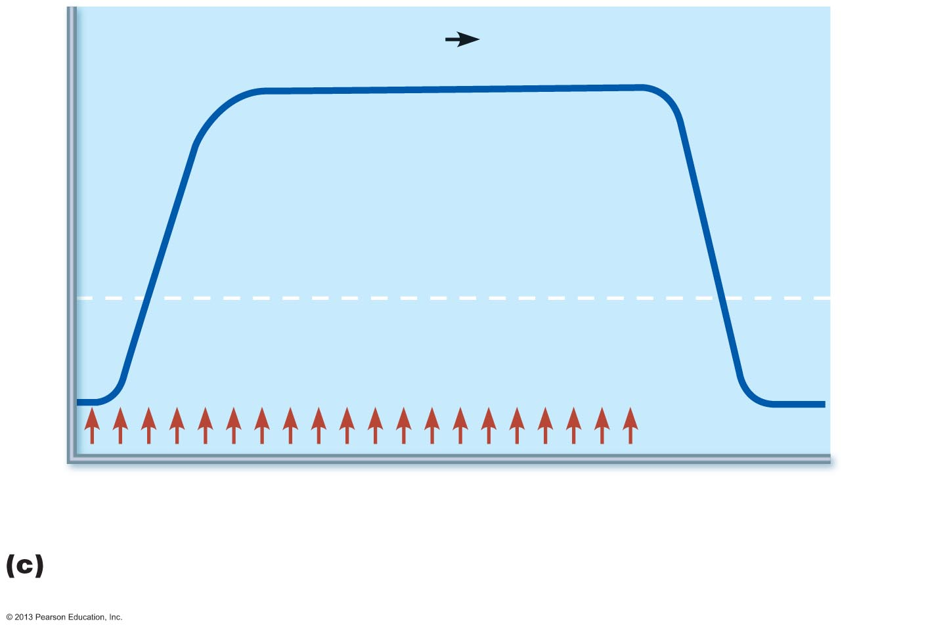
Figure 9.15c A muscle's response to changes in stimulation frequency.
High stimulation
frequency
fused (complete)
tetanus
Tension
Stimuli
0
100
200
300
Time (ms)
At higher stimulus frequencies, there is no relaxation at all
between stimuli. This is fused (complete) tetanus.
© 2013 Pearson Education, Inc.

Slide 19
Response to Change in Stimulus Strength
Recruitment (multiple motor unit summation) controls force of contraction
Subthreshold stimuli – no observable contractions
Threshold stimulus: stimulus strength causing first observable muscle contraction
Maximal stimulus – strongest stimulus that increases contractile force
© 2013 Pearson Education, Inc.

Slide 20
Response to Change in Stimulus Strength
Muscle contracts more vigorously as stimulus strength increases above threshold
Contraction force precisely controlled by recruitment – activates more and more muscle fibers
Beyond maximal stimulus no increase in force of contraction
© 2013 Pearson Education, Inc.

Slide 21
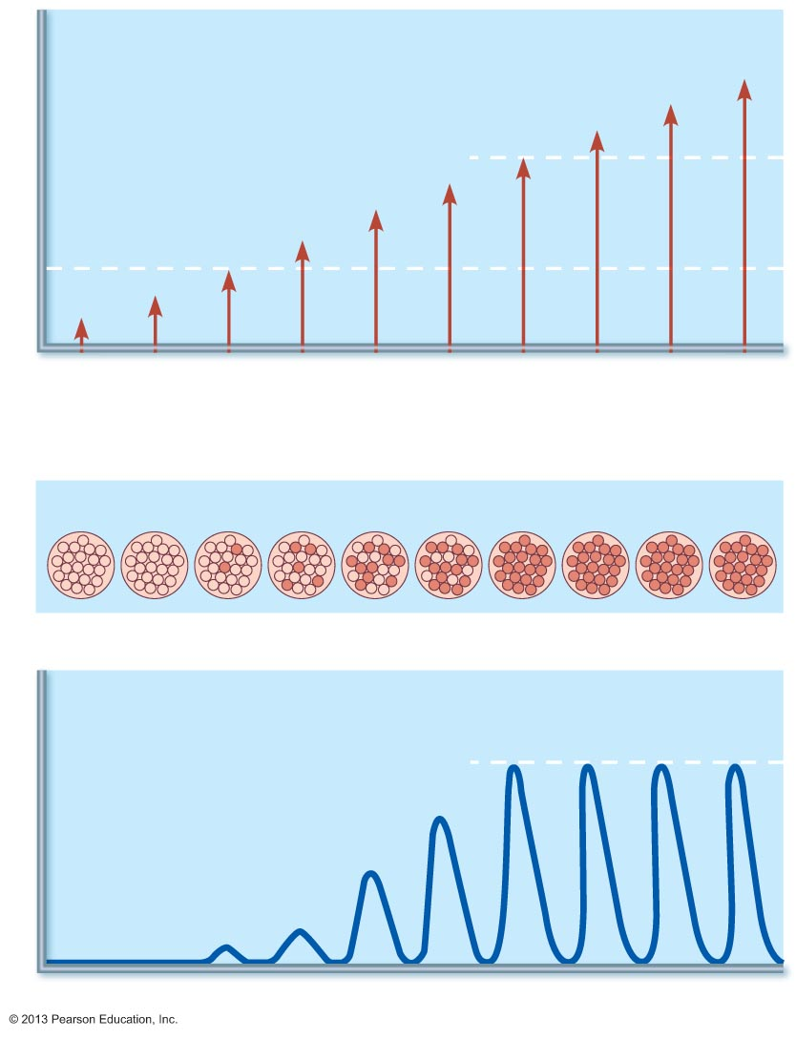
Figure 9.16 Relationship between stimulus intensity (graph at top) and muscle tension (tracing below).
Stimulus strength
Maximal
stimulus
Stimulus voltage
Threshold stimulus
1
2
3
4
5
6
7
8
9
10
Stimuli to nerve
Proportion of motor units excited
Strength of muscle contraction
Maximal contraction
Tension
Time (ms)
© 2013 Pearson Education, Inc.

Slide 22
Response to Change in Stimulus Strength
Recruitment works on size principle
  Motor units with smallest muscle fibers recruited first
  Motor units with larger and larger fibers recruited as stimulus intensity increases
  Largest motor units activated only for most powerful contractions
© 2013 Pearson Education, Inc.

Slide 23
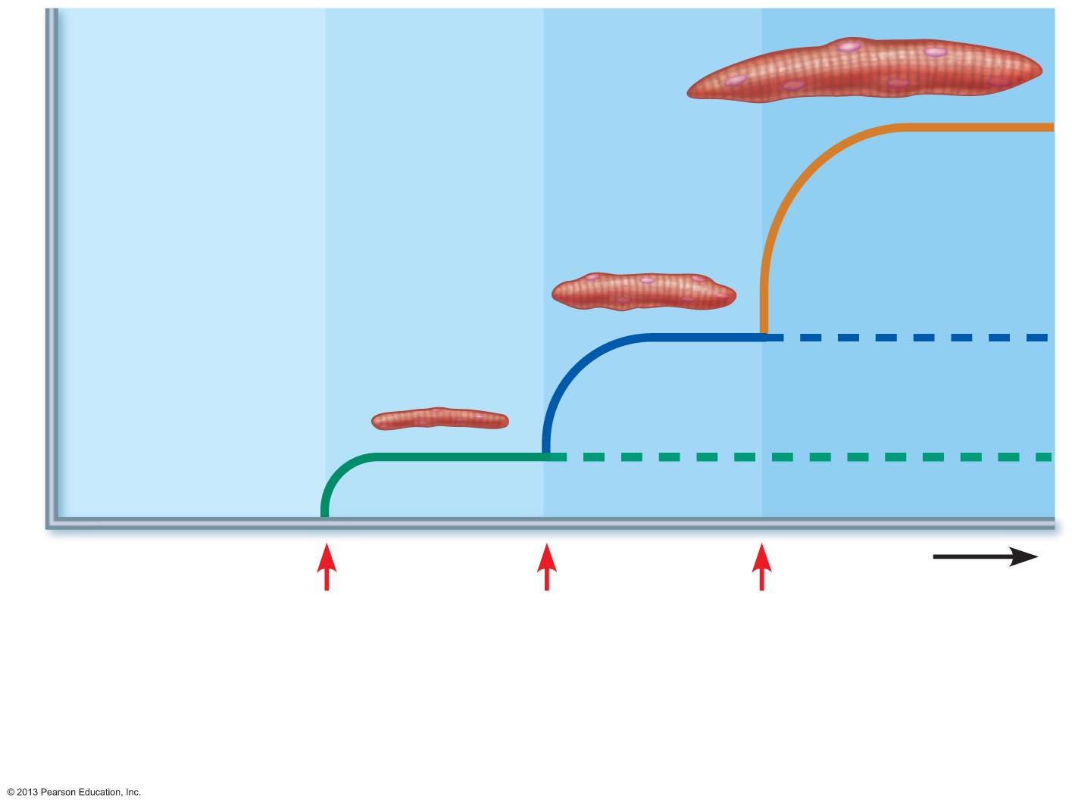
Figure 9.17 The size principle of recruitment.
Skeletal
muscle
fibers
Tension
Time
Motor
unit 1
recruited
(small
fibers)
Motor
unit 2
recruited
(medium
fibers)
Motor
unit 3
recruited
(large
fibers)
© 2013 Pearson Education, Inc.

Slide 24
Isotonic Contractions
Muscle changes in length and moves load
  Thin filaments slide
Isotonic contractions either concentric or eccentric:
  Concentric contractions—muscle shortens and does work
  Eccentric contractions—muscle generates force as it lengthens
© 2013 Pearson Education, Inc.

Slide 25
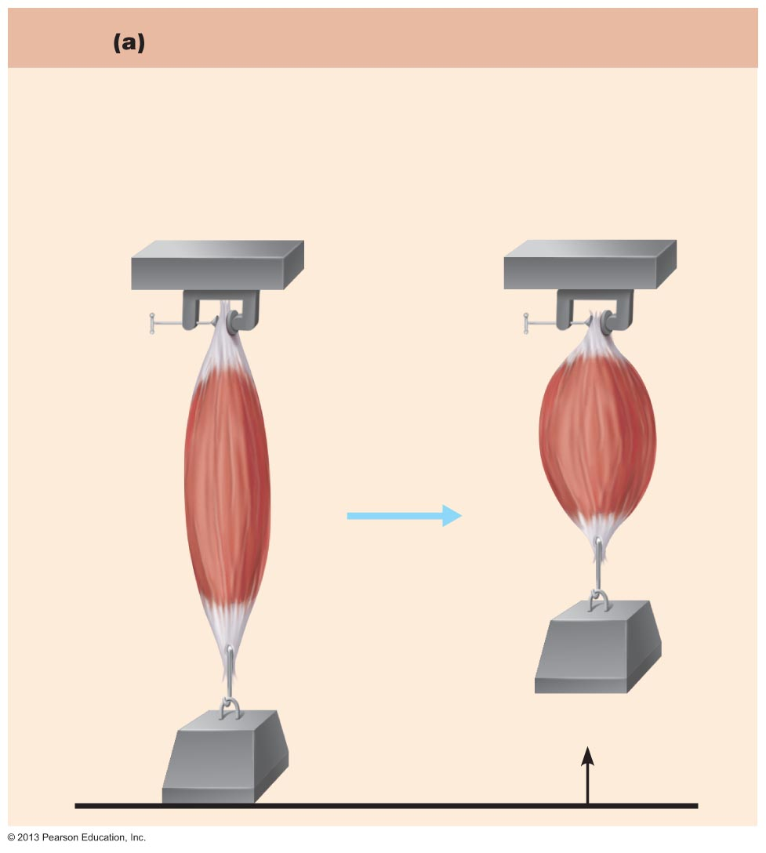
Figure 9.18a Isotonic (concentric) and isometric contractions. (1 of 2)
Isotonic contraction (concentric)
On stimulation, muscle develops enough tension (force)
to lift the load (weight). Once the resistance is overcome,
the muscle shortens, and the tension remains constant for
the rest of the contraction.
Tendon
Muscle
contracts
(isotonic
contraction)
3 kg
Tendon
3 kg
© 2013 Pearson Education, Inc.

Slide 26
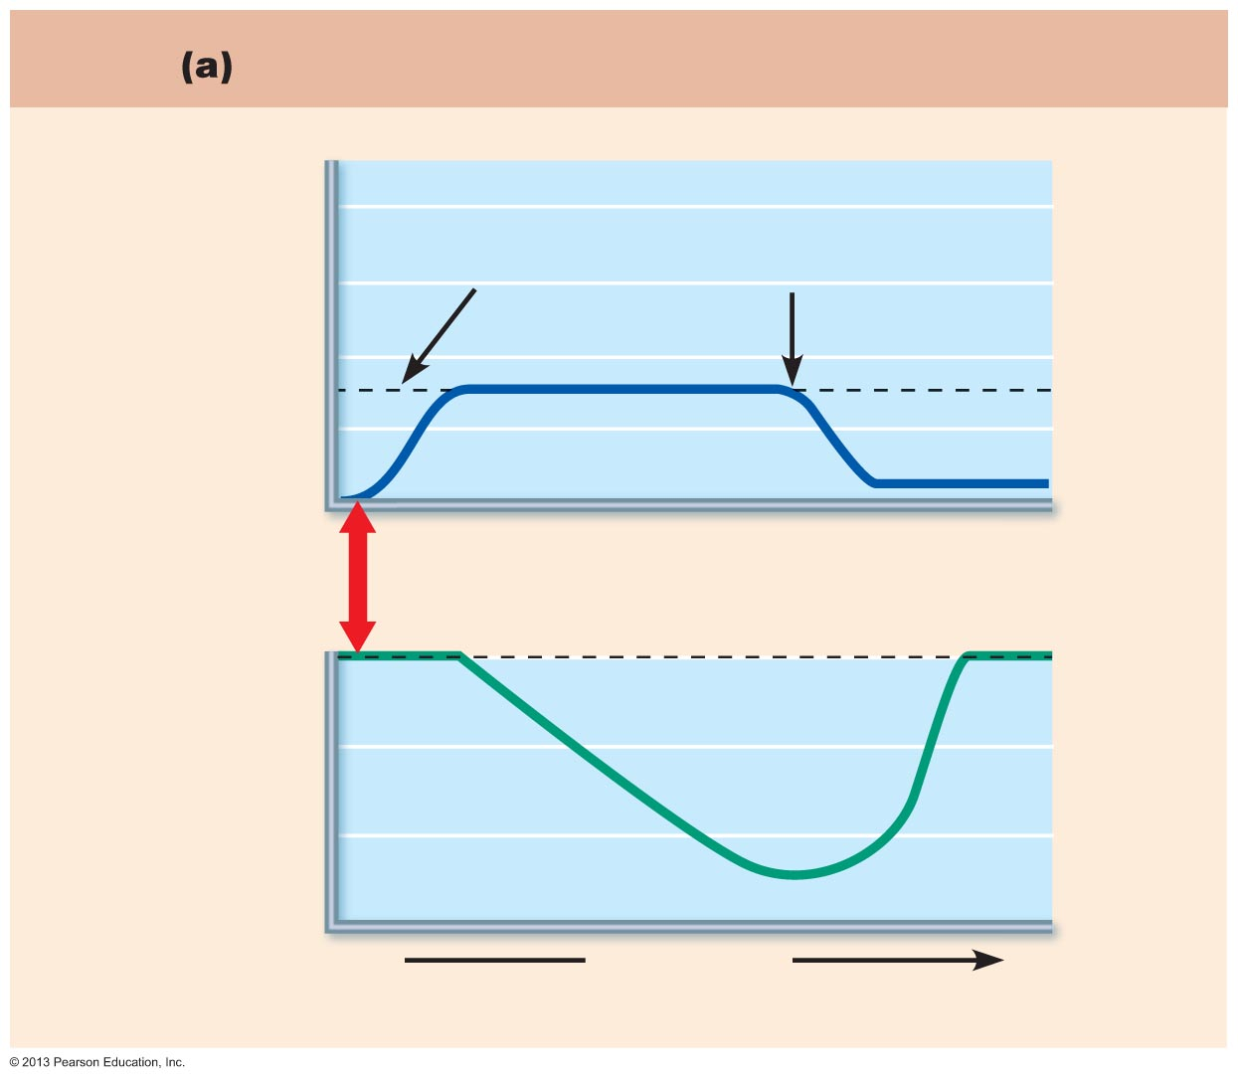
Figure 9.18a Isotonic (concentric) and isometric contractions. (2 of 2)
Isotonic contraction (concentric)
8
Amount of
resistance
Muscle
relaxes
6
Tension developed
(kg)
4
Peak tension
developed
2
0
Muscle
stimulus
Resting length
100
90
Muscle length (percent
of resting length)
80
70
Time (ms)
© 2013 Pearson Education, Inc.

Slide 27
Isometric Contractions
Load greater than tension muscle can develop
Tension increases to muscle's capacity, but muscle neither shortens nor lengthens
  Cross bridges generate force but do not move actin filaments
© 2013 Pearson Education, Inc.

Slide 28
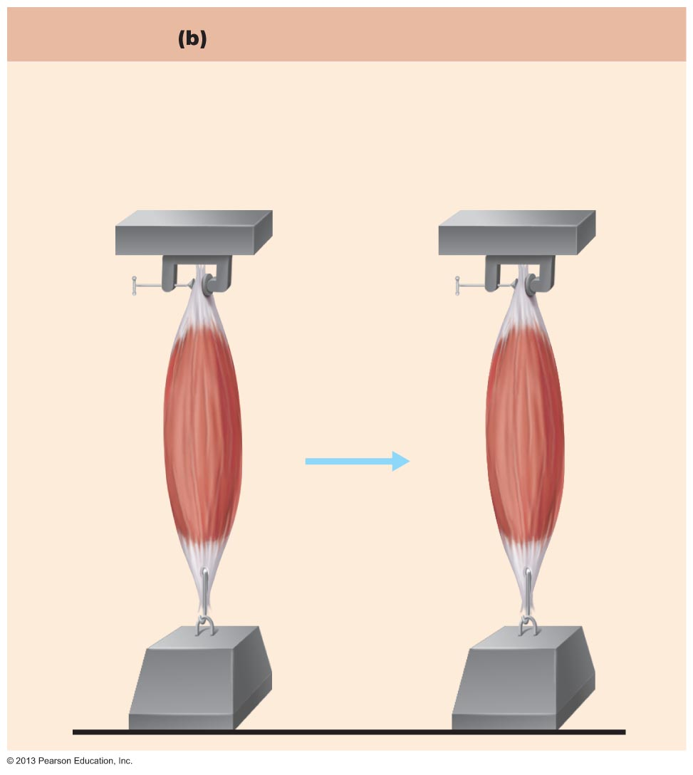
Figure 9.18b Isotonic (concentric) and isometric contractions. (1 of 2)
Isometric contraction
Muscle is attached to a weight that exceeds the muscle's
peak tension-developing capabilities. When stimulated, the
tension increases to the muscle's peak tension-developing
capability, but the muscle does not shorten.
Muscle
contracts
(isometric
contraction)
6 kg
6 kg
© 2013 Pearson Education, Inc.

Slide 29
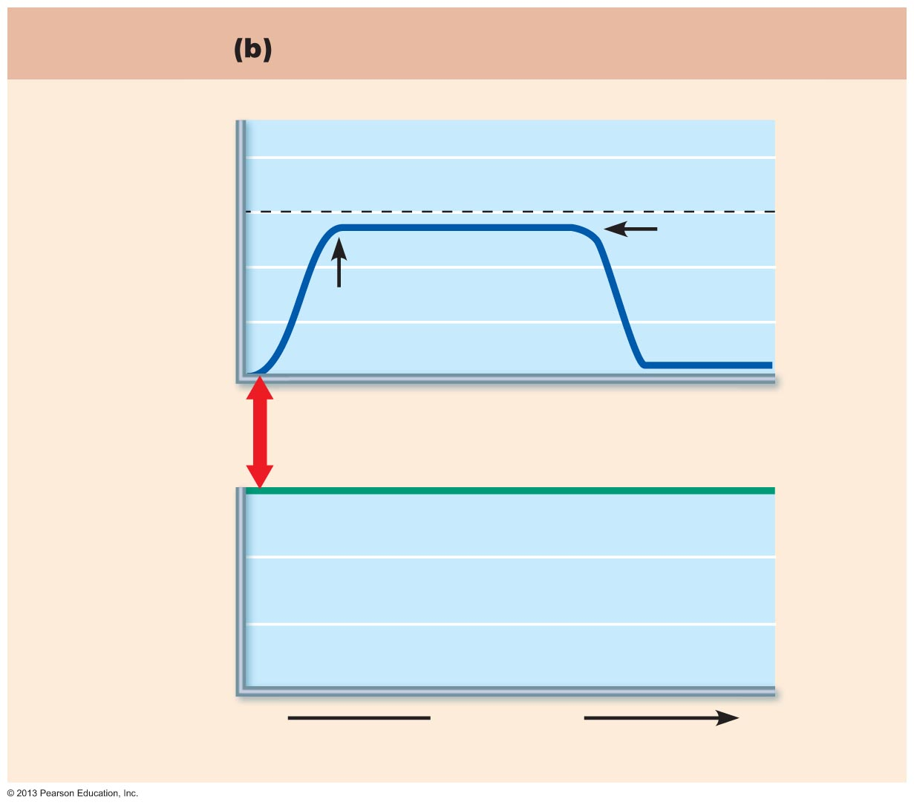
Figure 9.18b Isotonic (concentric) and isometric contractions. (2 of 2)
Isometric contraction
8
Amount of resistance
6
Tension developed
(kg)
Muscle
relaxes
4
2
Peak tension
developed
0
Muscle
stimulus
Resting length
100
90
Muscle length (percent
of resting length)
80
70
Time (ms)
© 2013 Pearson Education, Inc.

Slide 30
Muscle Tone
Constant, slightly contracted state of all muscles
Due to spinal reflexes
  Groups of motor units alternately activated in response to input from stretch receptors in muscles
Keeps muscles firm, healthy, and ready to respond
© 2013 Pearson Education, Inc.

Slide 31
Muscle Metabolism: Energy for Contraction
ATP only source used directly for contractile activities
  Move and detach cross bridges, calcium pumps in SR, return of Na⁺ & K⁺ after excitation-contraction coupling
Available stores of ATP depleted in 4–6 seconds
© 2013 Pearson Education, Inc.

Slide 32
Muscle Metabolism: Energy for Contraction
ATP regenerated by:
  Direct phosphorylation[化]磷酸化 of ADP by creatine phosphate (CP) 肌酸磷酸
  Anaerobic无氧 pathway (glycolysis → lactic acid 乳酸)
  Aerobic respiration需氧呼吸
  肌酸磷酸与糖原结合而发挥作用，为肌肉提供直接的能量。
© 2013 Pearson Education, Inc.

Slide 33
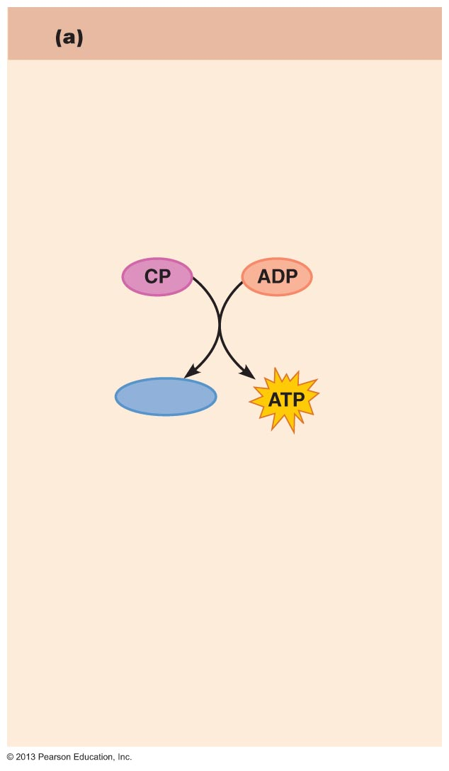
Figure 9.19a Pathways for regenerating ATP during muscle activity.
Direct phosphorylation
Coupled reaction of creatine
Phosphate (CP) and ADP
Energy source: CP
Creatine
kinase
Creatine
Oxygen use: None
Products: 1 ATP per CP, creatine
Duration of energy provided:
15 seconds
© 2013 Pearson Education, Inc.

Slide 34
Anaerobic Pathway
Glycolysis – does not require oxygen
  Glucose degraded to 2 pyruvic acid molecules
    Normally enter mitochondria → aerobic respiration
At 70% of maximum contractile activity
  Bulging muscles compress blood vessels; oxygen delivery impaired
  Pyruvic acid converted to lactic acid
© 2013 Pearson Education, Inc.

Slide 35
Anaerobic Pathway
Lactic acid
  Diffuses into bloodstream
  Used as fuel by liver, kidneys, and heart
  Converted back into pyruvic acid or glucose by liver
  Anaerobic respiration yields only 5% as much ATP as aerobic respiration, but produces ATP 2½ times faster
© 2013 Pearson Education, Inc.

Slide 36
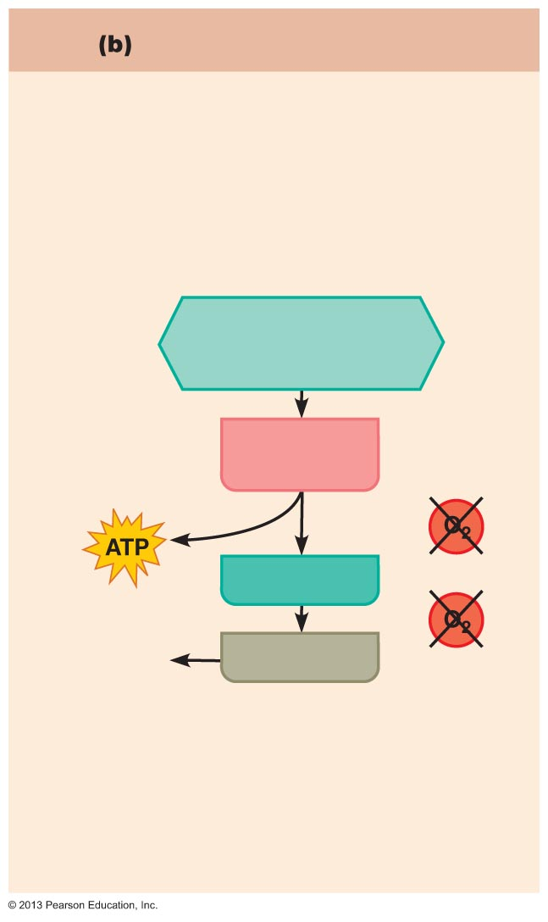
Figure 9.19b Pathways for regenerating ATP during muscle activity.
Anaerobic pathway
Glycolysis and lactic acid formation
Energy source: glucose
Glucose (from
glycogen breakdown or
delivered from blood)
Glycolysis
in cytosol
2
Pyruvic acid
net gain
Released
to blood
Lactic acid
Oxygen use: None
Products: 2 ATP per glucose, lactic acid
Duration of energy provided: 30-40
seconds, or slightly more
© 2013 Pearson Education, Inc.

Slide 37
Aerobic Pathway
Produces 95% of ATP during rest and light to moderate exercise; slow
Series of chemical reactions that require oxygen; occur in mitochondria
  Breaks glucose into CO₂, H₂O, and large amount ATP
Fuels - stored glycogen, then bloodborne glucose, pyruvic acid from glycolysis, and free fatty acids
© 2013 Pearson Education, Inc.

Slide 38
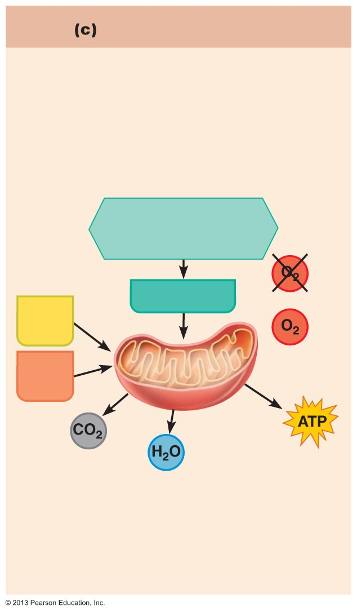
Figure 9.19c Pathways for regenerating ATP during muscle activity.
Aerobic pathway
Aerobic cellular respiration
Energy source: glucose; pyruvic acid; free
fatty acids from adipose tissue; amino
acids from protein catabolism
Glucose (from
glycogen breakdown or
delivered from blood)
Pyruvic acid
Fatty
acids
Aerobic respiration
in mitochondria
Amino
acids
Aerobic respiration
in mitochondria
32
net gain per
glucose
Oxygen use: Required
Products: 32 ATP per glucose, CO₂, H₂O
Duration of energy provided: Hours
© 2013 Pearson Education, Inc.

Slide 39
Energy Systems Used During Sports
Aerobic endurance
  Length of time muscle contracts using aerobic pathways
Anaerobic threshold
  Point at which muscle metabolism converts to anaerobic
© 2013 Pearson Education, Inc.

Slide 40
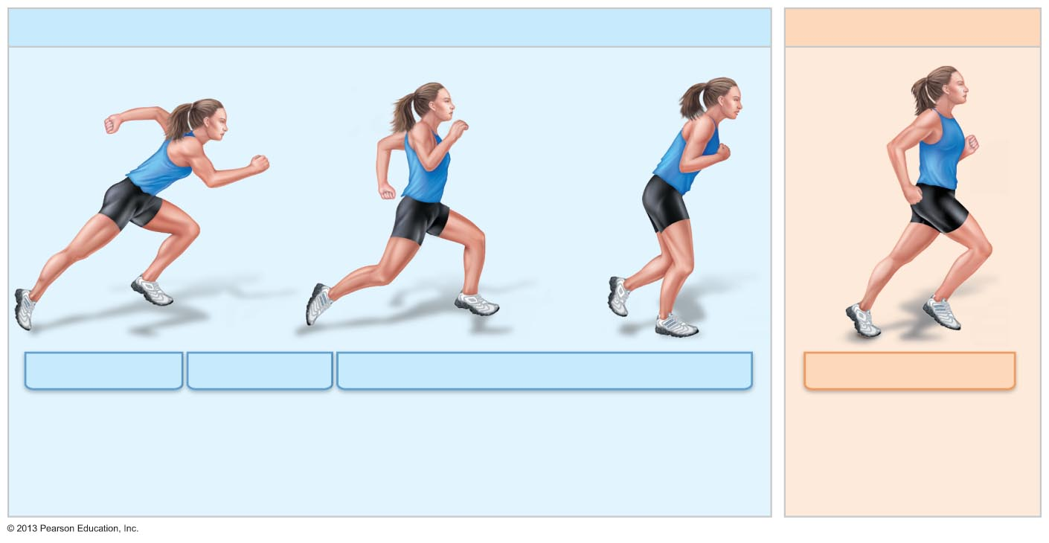
Figure 9.20 Comparison of energy sources used during short-duration exercise and prolonged-duration exercise.
Short-duration exercise
Prolonged-duration exercise
6 seconds
10 seconds
30–40 seconds
End of exercise
Hours
ATP stored in
muscles is
used first.
ATP is formed from
creatine phosphate
and ADP (direct
phosphorylation).
Glycogen stored in muscles is broken down to glucose,
which is oxidized to generate ATP (anaerobic pathway).
ATP is generated by breakdown
of several nutrient energy fuels by
aerobic pathway.
© 2013 Pearson Education, Inc.

Slide 41
Muscle Fatigue疲劳
Physiological inability to contract despite continued stimulation
Occurs when
  Ionic imbalances (K⁺, Ca²⁺, P_{i}) interfere with E‑C coupling
  Prolonged exercise may damage SR and interferes with Ca²⁺ regulation and release
Total lack of ATP occurs rarely, during states of continuous contraction, and causes contractures (continuous contractions)
© 2013 Pearson Education, Inc.

Slide 42
Excess Postexercise Oxygen Consumption
To return muscle to resting state
  Oxygen reserves replenished
  Lactic acid converted to pyruvic acid
  Glycogen stores replaced
  ATP and creatine phosphate reserves replenished
All require extra oxygen; occur post exercise
© 2013 Pearson Education, Inc.

Slide 43
Heat Production During Muscle Activity
~40% of energy released in muscle activity useful as work
Remaining energy (60%) given off as heat
Dangerous heat levels prevented by radiation of heat from skin and sweating
Shivering - result of muscle contractions to generate heat when cold
© 2013 Pearson Education, Inc.

